Slide 1
ED351 Educational Psychology House–Tree–Person Practical Theory
Title: House–Tree–Person Practical Theory
Subtitle: John Buck’s Model Continued by Donald Uhlin
Aaron Loos
Dr. Palacios - ED351 Educational Psychology
May 1, 2026

Slide 2
about the topic example:
As an inner-city Chaplain serving in felony recovery work in downtown Seattle, I have used this pencil-drawing concept as a practical tool to better understand and help those navigating difficult life circumstances. My first exposure to this approach came during my junior high years, when Dr. Donald Ulin demonstrated the concept in a small group setting at his home. The impact of that experience was profound. Even decades later, I can recall the details of his explanation and have continued to reflect on and apply those insights since 1978.
Recently, I obtained a copy of Art for Exceptional Children, and it confirmed the very principles I learned years ago. In this presentation, I aim to share this model in a clear and accessible way, demonstrating how simple drawings can serve as meaningful entry points for understanding, communication, and growth.

Slide 3
House–Tree–Person Practical Theory
A Creative Window into Learning & Experience
The House–Tree–Person model has roots reaching back into early projective drawing approaches of the late 19th century and was later formalized by John N. Buck in 1948. This method uses simple drawings as a way to explore inner experiences, particularly when individuals may struggle to express themselves verbally.

Slide 4
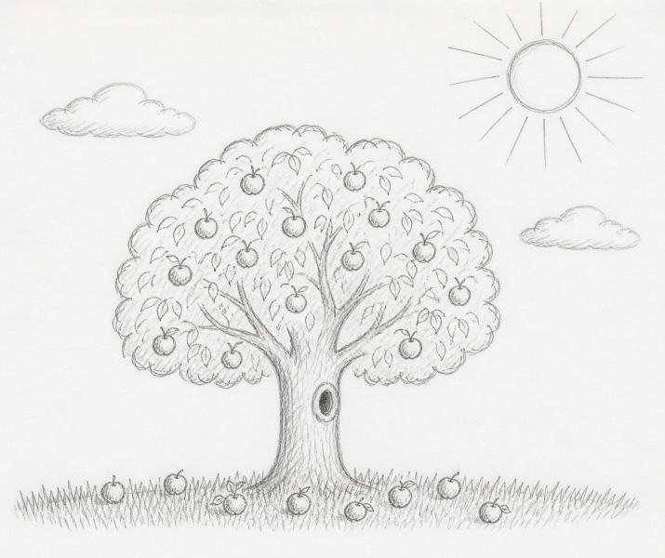
This is an AI version of
what I drew in 1978. Being
the youngest of three boys,
I had a wide-eyed look at
everything in life. When my
oldest brother left home and
moved across the country, it affected me in a devastating way. I thought that I was doing everything I could, but I saw that many things didn't work out. I didn't intend to explain all of that, it just showed in the way that I drew a tree.

Slide 5
Slide 2 – Purpose
The purpose of HTP drawing method
Explain its educational and counseling use
Connect to art education and exceptional learners
Apply insights to real-world teaching
Counseling is not used as a “Cheap Parlor Trick.”

Slide 6
Slide 3 – Background
Developed by John N. Buck (1948)
Projective drawing technique
Used in psychology and counseling settings
Encourages nonverbal expression
Continued by Dr. Donald Uhlin (1972)
The H-T-P Theory stems from ample observation.

Slide 7
Slide 4 - Core Idea
People express inner experiences through drawings
Drawings may reflect perceptions, emotions, and relationships
Especially helpful when words are difficult
It’s not what you drew, it’s how you drew it.

Slide 8
Slide 5 – The Three Drawings
🏠 House – home life, security, relationships
🌳 Tree – inner self, growth, emotional state
👤 Person – self-image, identity
Each sketch displays one’s “style” of mindset.

Slide 9
Slide 6 – How It Works
Draw a house, tree, and person
Observe details and patterns
Ask follow-up questions
Discuss meaning with the learner
Dr. Uhlin started with prison inmates.

Slide 10
Slide 7 – Educational Value
Encourages creative expression
Supports students with learning difficulties
Provides insight into emotional experience
Builds communication pathways
Some inmates had no idea WHY they committed crimes, drawing it out opened the understanding.

Slide 11
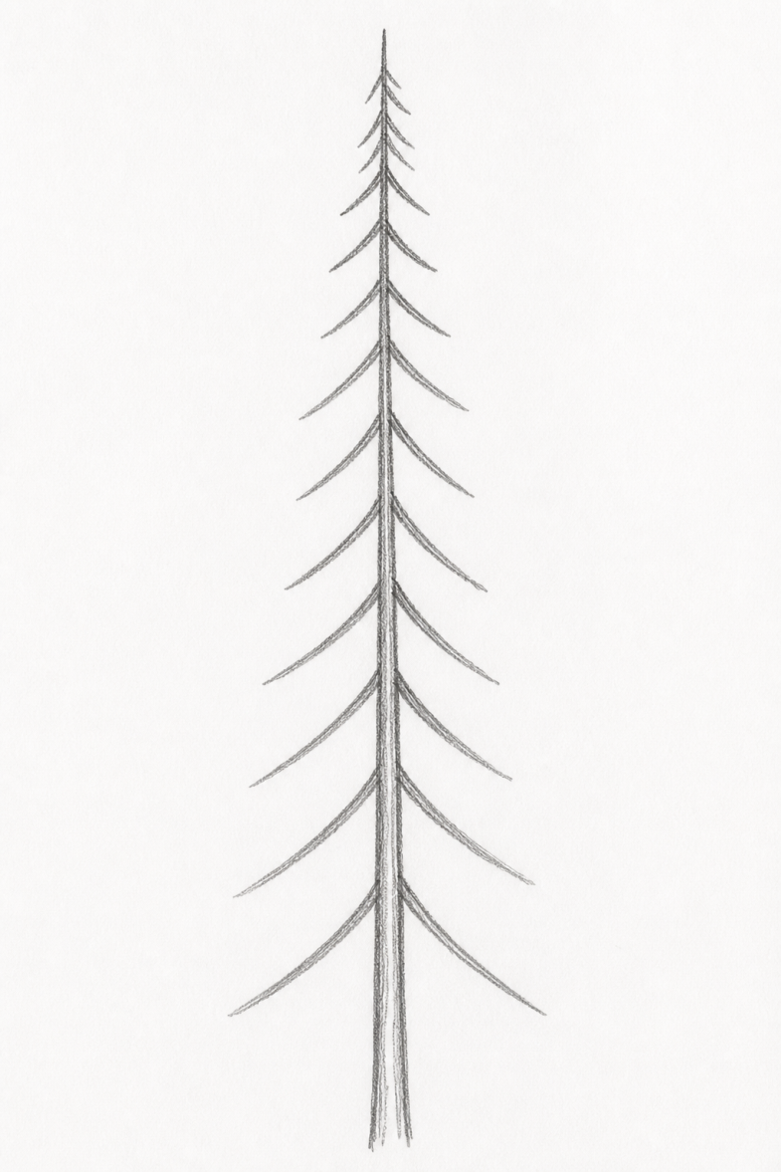
This is an AI version of what my middle brother drew in 1978. As the middle child in our family, he developed a personality that has always been direct and straightforward. His thoughts are clear, and structured.
The tall, narrow form and minimal branching suggest a sense of purpose and focus rather than distraction.

Slide 12
Slide 8 – Connection to Art Education
Encourages creative expression
Supports students with learning difficulties
Provides insight into emotional experience
Builds communication pathways
This is not therapy as much as it is clarifying personal history.

Slide 13
Slide 9 – Uhlin’s Contribution
Emphasis on art for exceptional learners
Focus on expression rather than perfection
Encourages confidence and participation
Aligns with relational teaching methods
It was 1978 and I was a Jr. High kid listening to Dr. Uhlin for the first time. Every idea stuck in my mind.

Slide 14
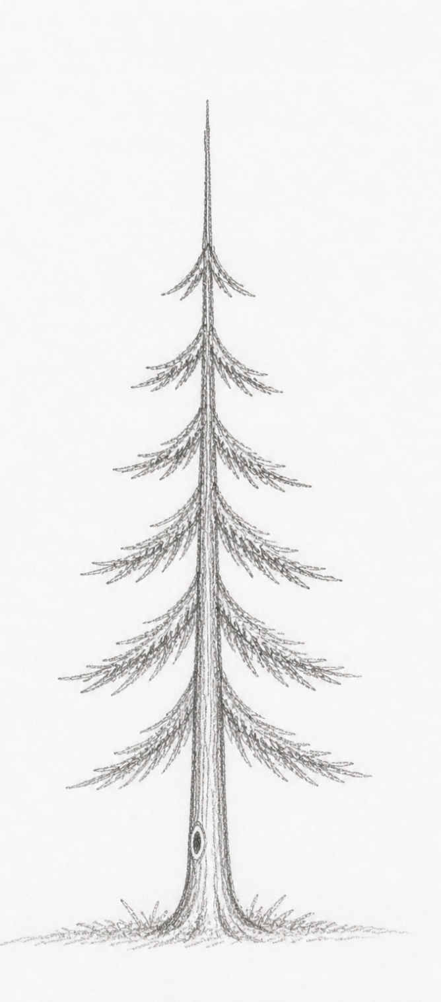
This is an AI example of the drawing a 72-year-old felon provided.
I spoke with this older inmate, and after seeing his drawing, I immediately had to ask him about his painful childhood. I was curious and inquired if his mother knew that he was being molested as an elementary age kid. He immediately confirmed that it happened and it was extremely painful. He followed up by saying, “but no one wants to hear about it.” My first response was, would you like to get some coffee? I'll buy.

Slide 15
Slide 10 – Practical Application
Use drawings to start conversations
Ask open-ended questions
Listen without assuming
Build trust through engagement
We drew a house and people next to the house. My house had a long driveway and a fence.

Slide 16
Slide 11 – Example Questions
“Tell me about your tree…”
“Who lives in this house?”
“What is happening in this picture?”
“How does this represent you?”
My drawing of a chimney with smoke showed a confidence in my own personality. Helpful

Slide 17
Slide 12 – Strengths
Accessible to all learners
Encourages participation
Reveals emotional themes
Supports relational teaching
It was hard to accept that my tree had fruit on the ground showing failed efforts.

Slide 18
Slide 13 – Limitations
Interpretations are subjective
Perceived as a “Cheap Parlor Trick”
Requires careful, ethical use
Must be paired with conversation
Some of the deaf folks at the meeting just denied the explanation. They were not ready.

Slide 19
Slide 14 – Comparison to Behaviorism
Skinner: observable behavior, reinforcement
HTP: internal expression, meaning
Both valuable in different contexts
I began to use this HTP method in difficult counseling and at felony recover housing.

Slide 20
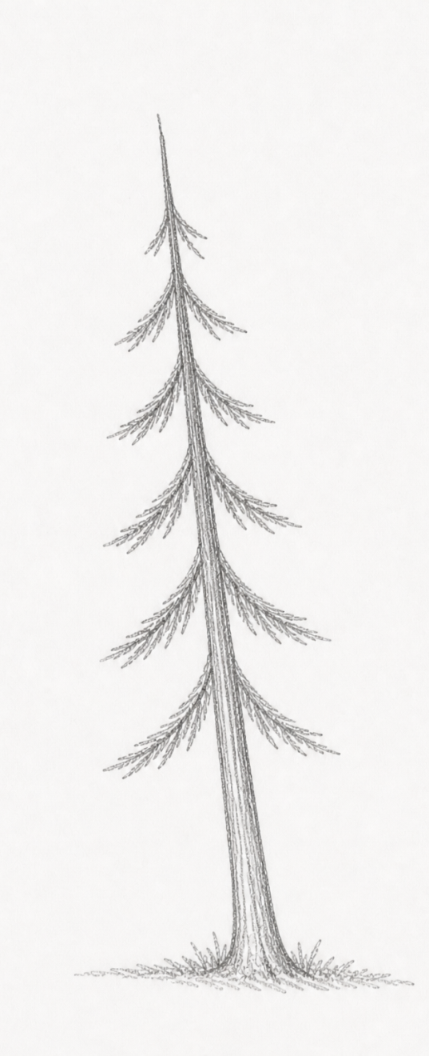
This is an AI example of the drawing a bride-to-be had drawn. She had a great testimony for the Lord and wanted to be transparent about their past problems. After she drew a tree that leaned to the left, I asked her if she did not get along with her dad at this time. She leveled with her future husband and me saying that she couldn't stand him at all. He was mean and overbearing to an extreme degree. She could not wait to get away from him. It was something that she didn't know how to deal with, and she did not want to bring this into her marriage.

Slide 21
Slide 15 – Biblical Integration
📖 God looks at the heart (1 Samuel 16:7)
📖 Communication beyond words (Psalm 19:1)
📖 Listening with understanding (James 1:19)
…Jesus stooped down, and with his finger wrote on the ground. John 8:6 WOW, what did he draw?

Slide 22
Slide 16 – Ministry Application
Helps individuals express hidden struggles
Encourages safe dialogue
Supports emotional and spiritual growth
Builds trust and relationship
Counseling begins with gaining comfortable trust.

Slide 23
Slide 17 – Personal Reflection
Learning through relationship
Expression reveals deeper understanding
Art can open doors words cannot
When that 72 inmate was able to discuss his past, he began a long and steady healing process.

Slide 24
Slide 18 – Key Insight
Drawings are not answers…
They are invitations to understanding.
When applied to the counselor’s understanding, it is possible to provide a better focus of helpful conversations that leads to recovery and healing.

Slide 25
Slide 19 – Conclusion
HTP is a helpful exploratory tool
Art provides access to internal experience
Best used with care, humility, and conversation
God gives wisdom and understanding

Slide 26
Slide 20 – References
Buck, J. N. (1948). House–Tree–Person Technique
Uhlin, D. H. Art for Exceptional Children
The Holy Bible, KJV

